Slide 1
Node, WebMatrix and Azure
Easy, UI-based and powerful.

Slide 2

Who?
Niels Robin Aagaard
@nielsrobin
github.com/nielsrobin
Background
Head of IT @ Trollbeads
Technology enthusiast
Whiskey lover

Slide 3






Why?
=
Free (*)
Easy deployment
IDE friendly development
Fast

Slide 4
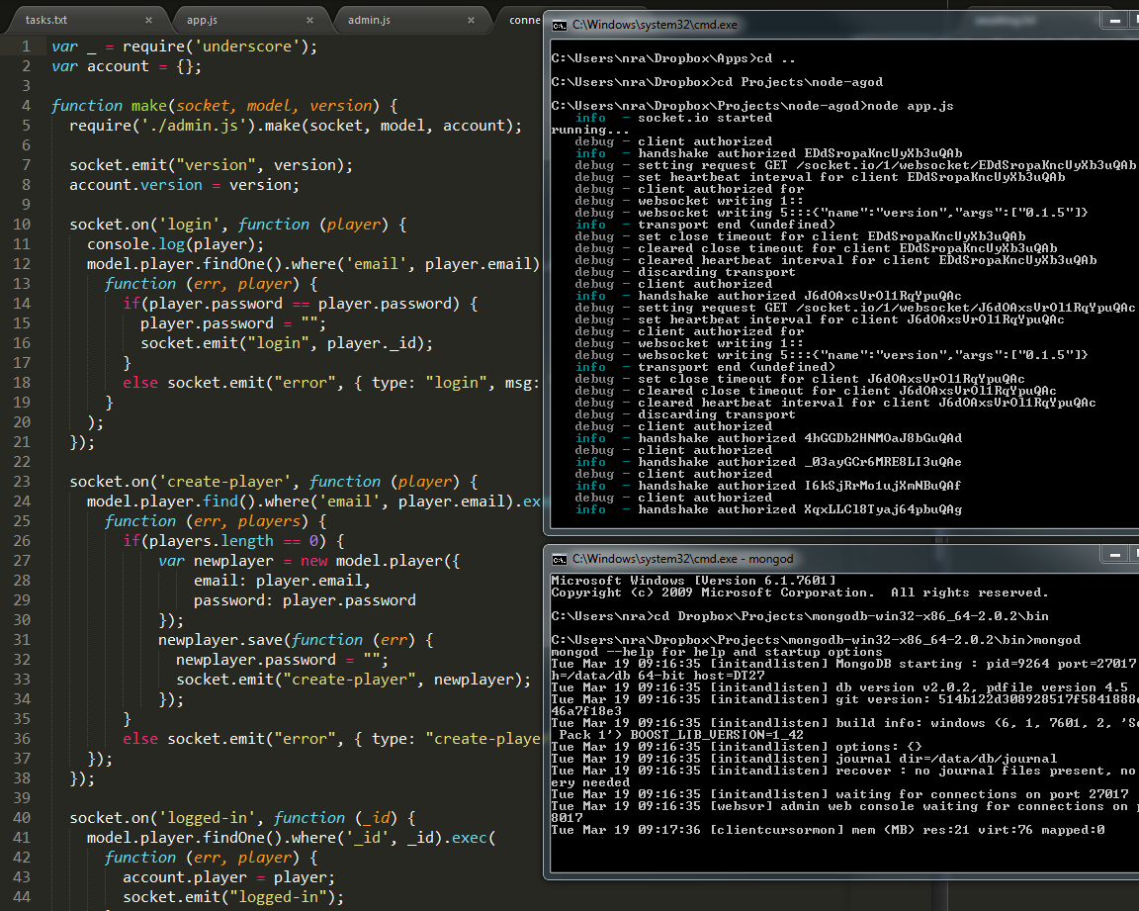
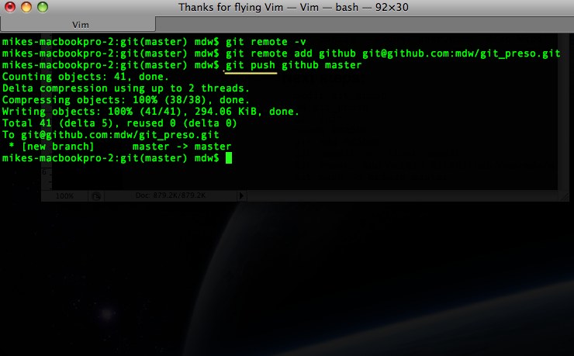
[Insert workspace from mac]
Node (terminal)
Npm (terminal)
Package.json
Mongod (terminal)
Git

Slide 5
Create and deploy
Create new project (WebMatrix)
Create new website (Azure)
Publish from WebMatrix to Azure

Slide 6
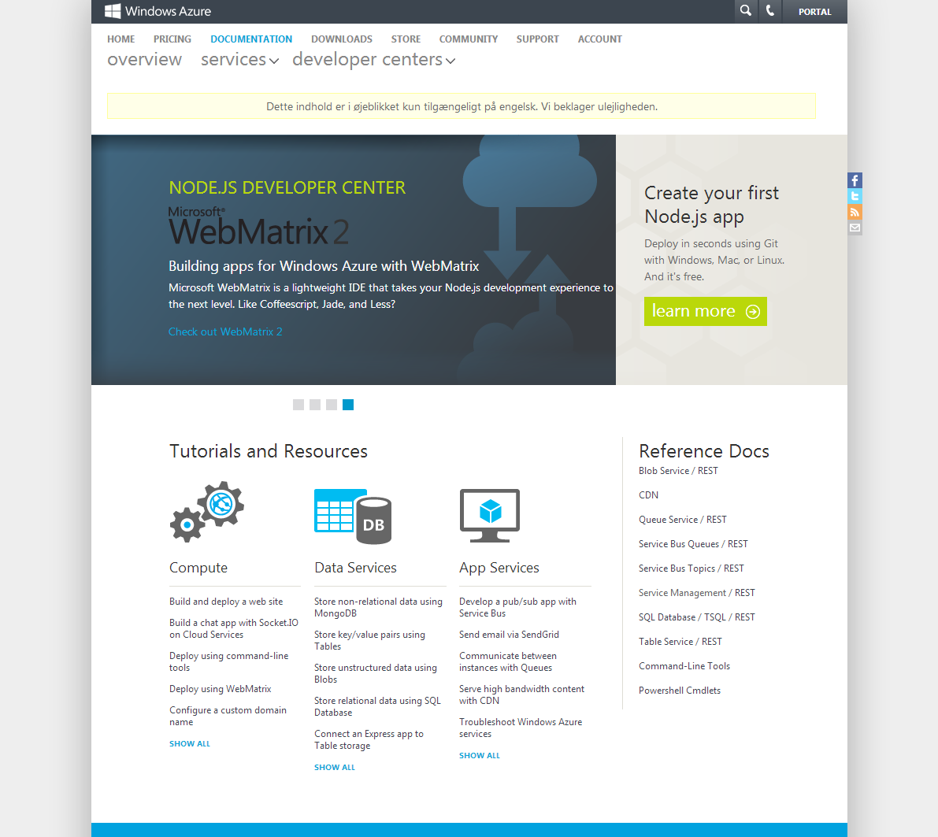
http://www.windowsazure.com/en-us/develop/nodejs/

Slide 7
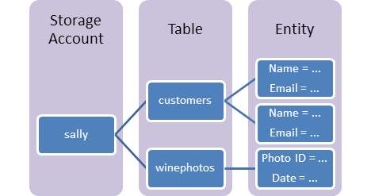
Table Services
Stores key/value pairs

Slide 8
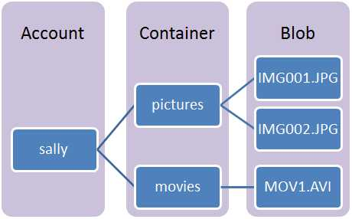
Blob Services?

Slide 9
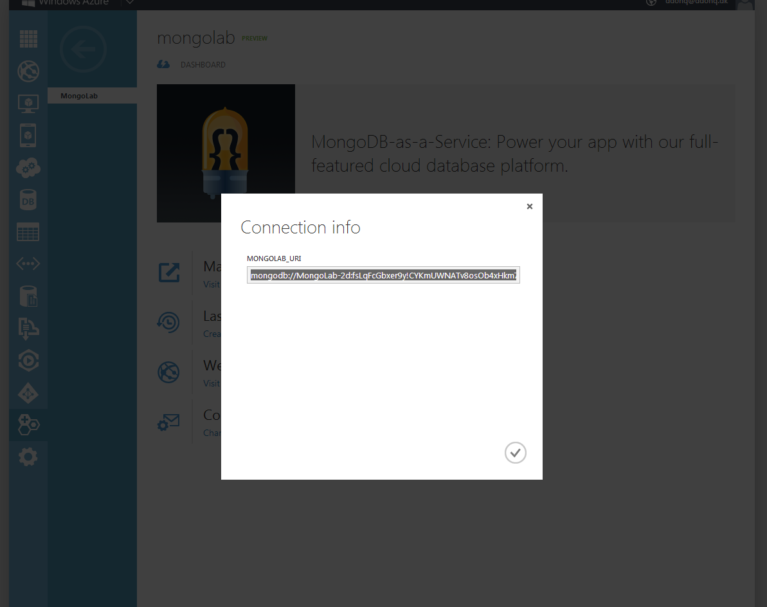
Azure and MongoDB

Slide 10
Azure and Dropbox?

Slide 11
Azure and Github?

Slide 12

Would you use WebMatrix?
Have I convinced you that Azure is worth looking into?

Slide 13
Niels Robin Aagaard
@nielsrobin
github.com/nielsrobin

Slide 14
Shortned urls
http://bit.ly/cphjsa Basic
http://bit.ly/cphjsb Tables
http://bit.ly/cphjsd Dropbox/Mongo
http://bit.ly/cphjsf Github
http://cphjs0X.azurewebsites.net/

